Slide 1
Controlled manipulation of single atoms and small molecules using the scanning tunnelling microscope
Karina Morgenstern , Nicolas Lorente,and Karl-Heinz Rieder
小组成员：袁伟，芦宏，魏祎雯，赵欣欣，张成龙，王磊，蔡超逸，汪知昌
Phys. Status Solidi B, 1–81 (2013)/DOI 10.1002/pssb.201248392

Slide 2
Advantages of STM:
1. real-space atomic resolution imaging
2.Electronic structure (local density of electronic states )
3.Investigate physical/chemical properties at atomic level
4.Atomic and molecular manipulation

Slide 3
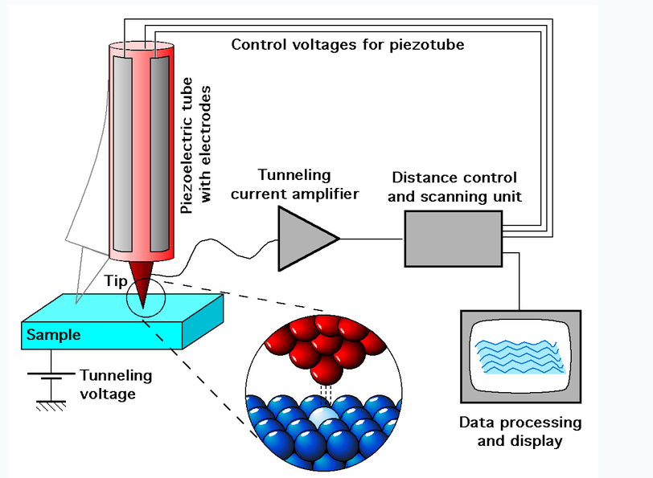
1. Introduction：
Schematic view of an STM

Slide 4
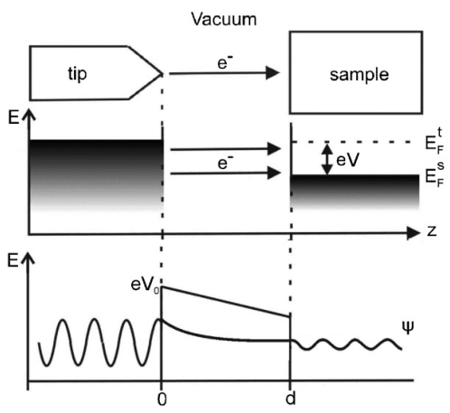
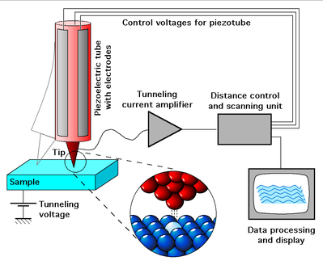
STM work principle

Slide 5
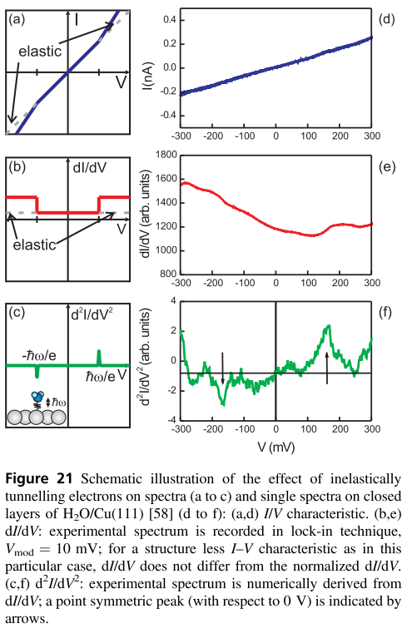
Elastic tunneling
Inelastic tunneling

Slide 6
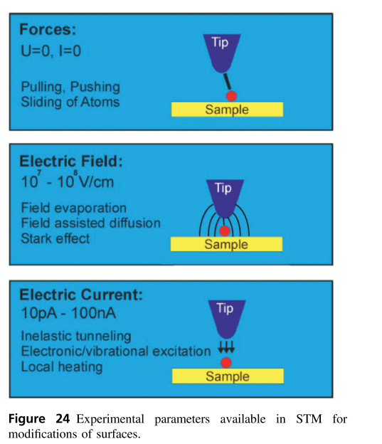
Manipulation：
three different parameters for modiﬁcations of surfaces：
forces between tip and surface
(ii) electrical field between tip and substrate
(iii) electron tunnelling current.

Slide 7
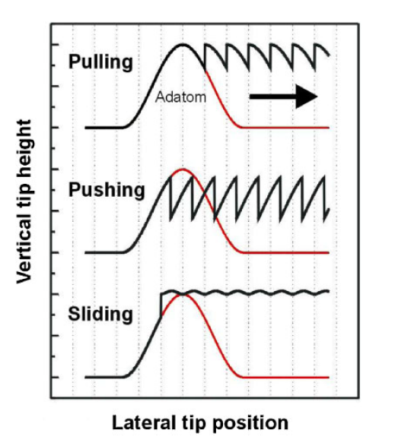
Lateral manipulation:

Slide 8
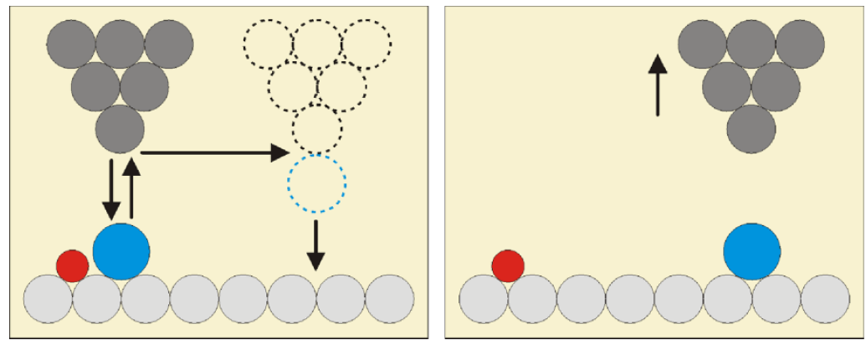
Vertical manipulation:

Slide 9
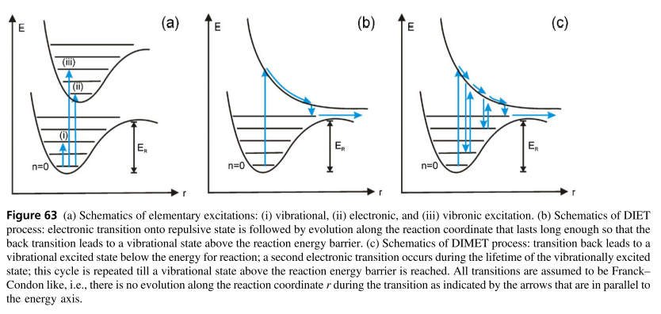
Manipulation employing the electron current

Slide 10
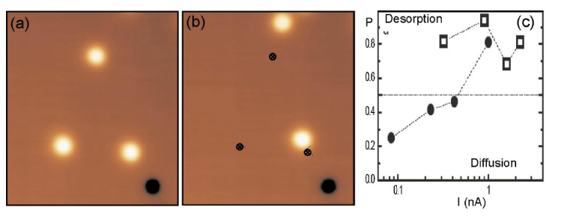

Molecule chemistry with the STM
Diffusion and desorption：

Slide 11
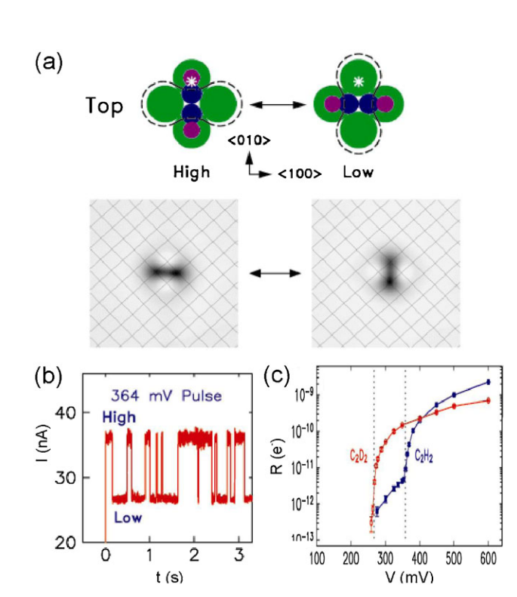
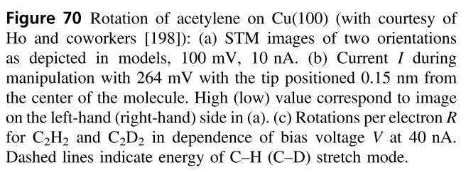
Rotation：

Slide 12
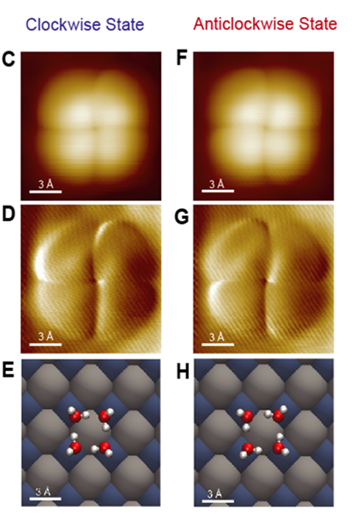
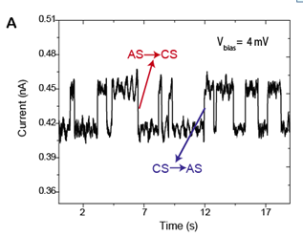

Slide 13
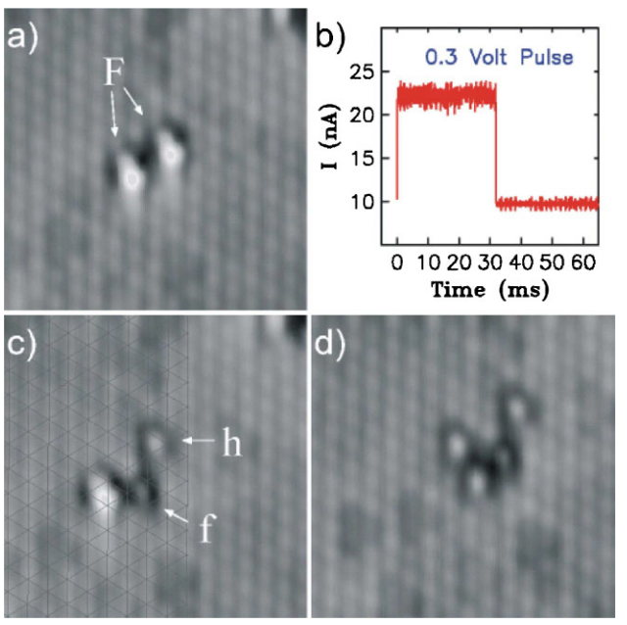
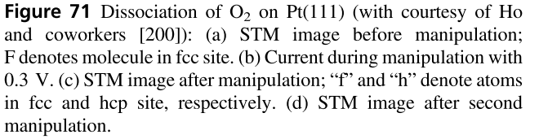
Bond breaking:

Slide 14
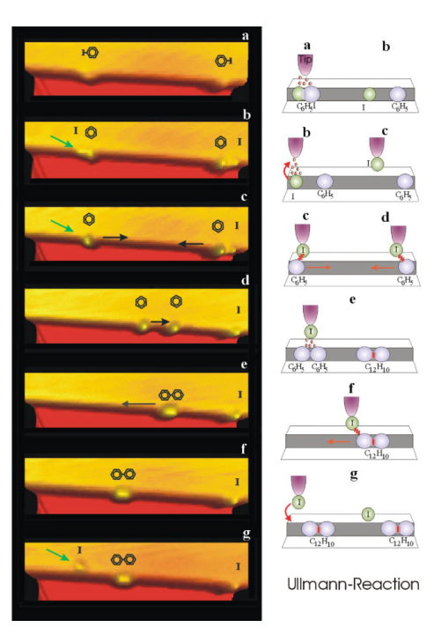
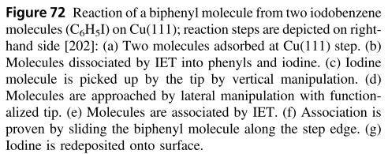
Chemical reaction:

Slide 15

thank
you！

